Slide 1
WCF COSMO DAY 2023
SUMMARY: Guidance ONLY. Clubs may opt to follow a different program and that is welcomed. This is a guide to assist those that may need assistance during your planning phase for Cosmo Day as needed.

Slide 2
Funding:
WCF currently has funding for clubs to support their Cosmo Day activities. (Up to $500.00)
To access these funds, clubs should submit a budget outlining their proposed use of funds and email it to the WCF Treasurer. This should happen very early in the year; the current process actually requests a 60-day notice.
Once funding is approved, you will submit your expenses in line with what was approved after you have completed your Cosmo Day activities, and the Club will be reimbursed pursuant to the Bylaws and Procedures of WCF-CI.

Slide 3
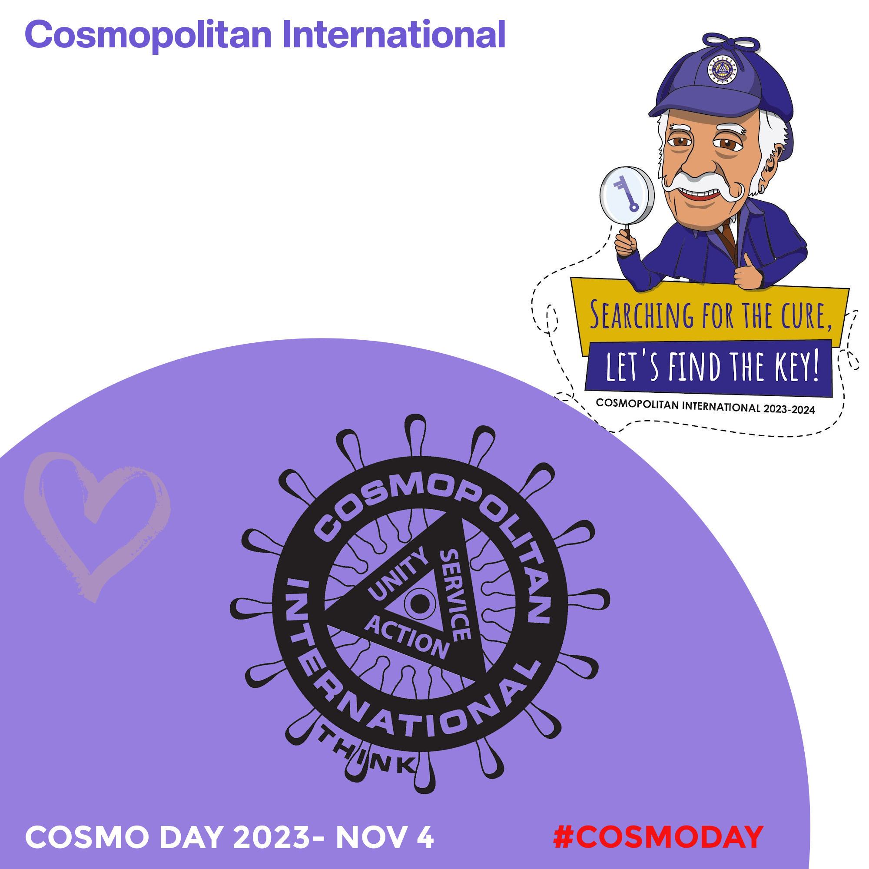
MARKETING SUPPORT 2023 COSMO DAY
Infographics….
Built with space to customize your message.
These next six images can be saved and used as website and social media promotions (fbook, instagram etc).
Customize as needed to make it relevant for your location.

Slide 4
MARKETING SUPPORT 2023 COSMO DAY
Infographics….
Uniting Communities Eradicating Diabetes
Cosmo Day Empowers

Slide 5
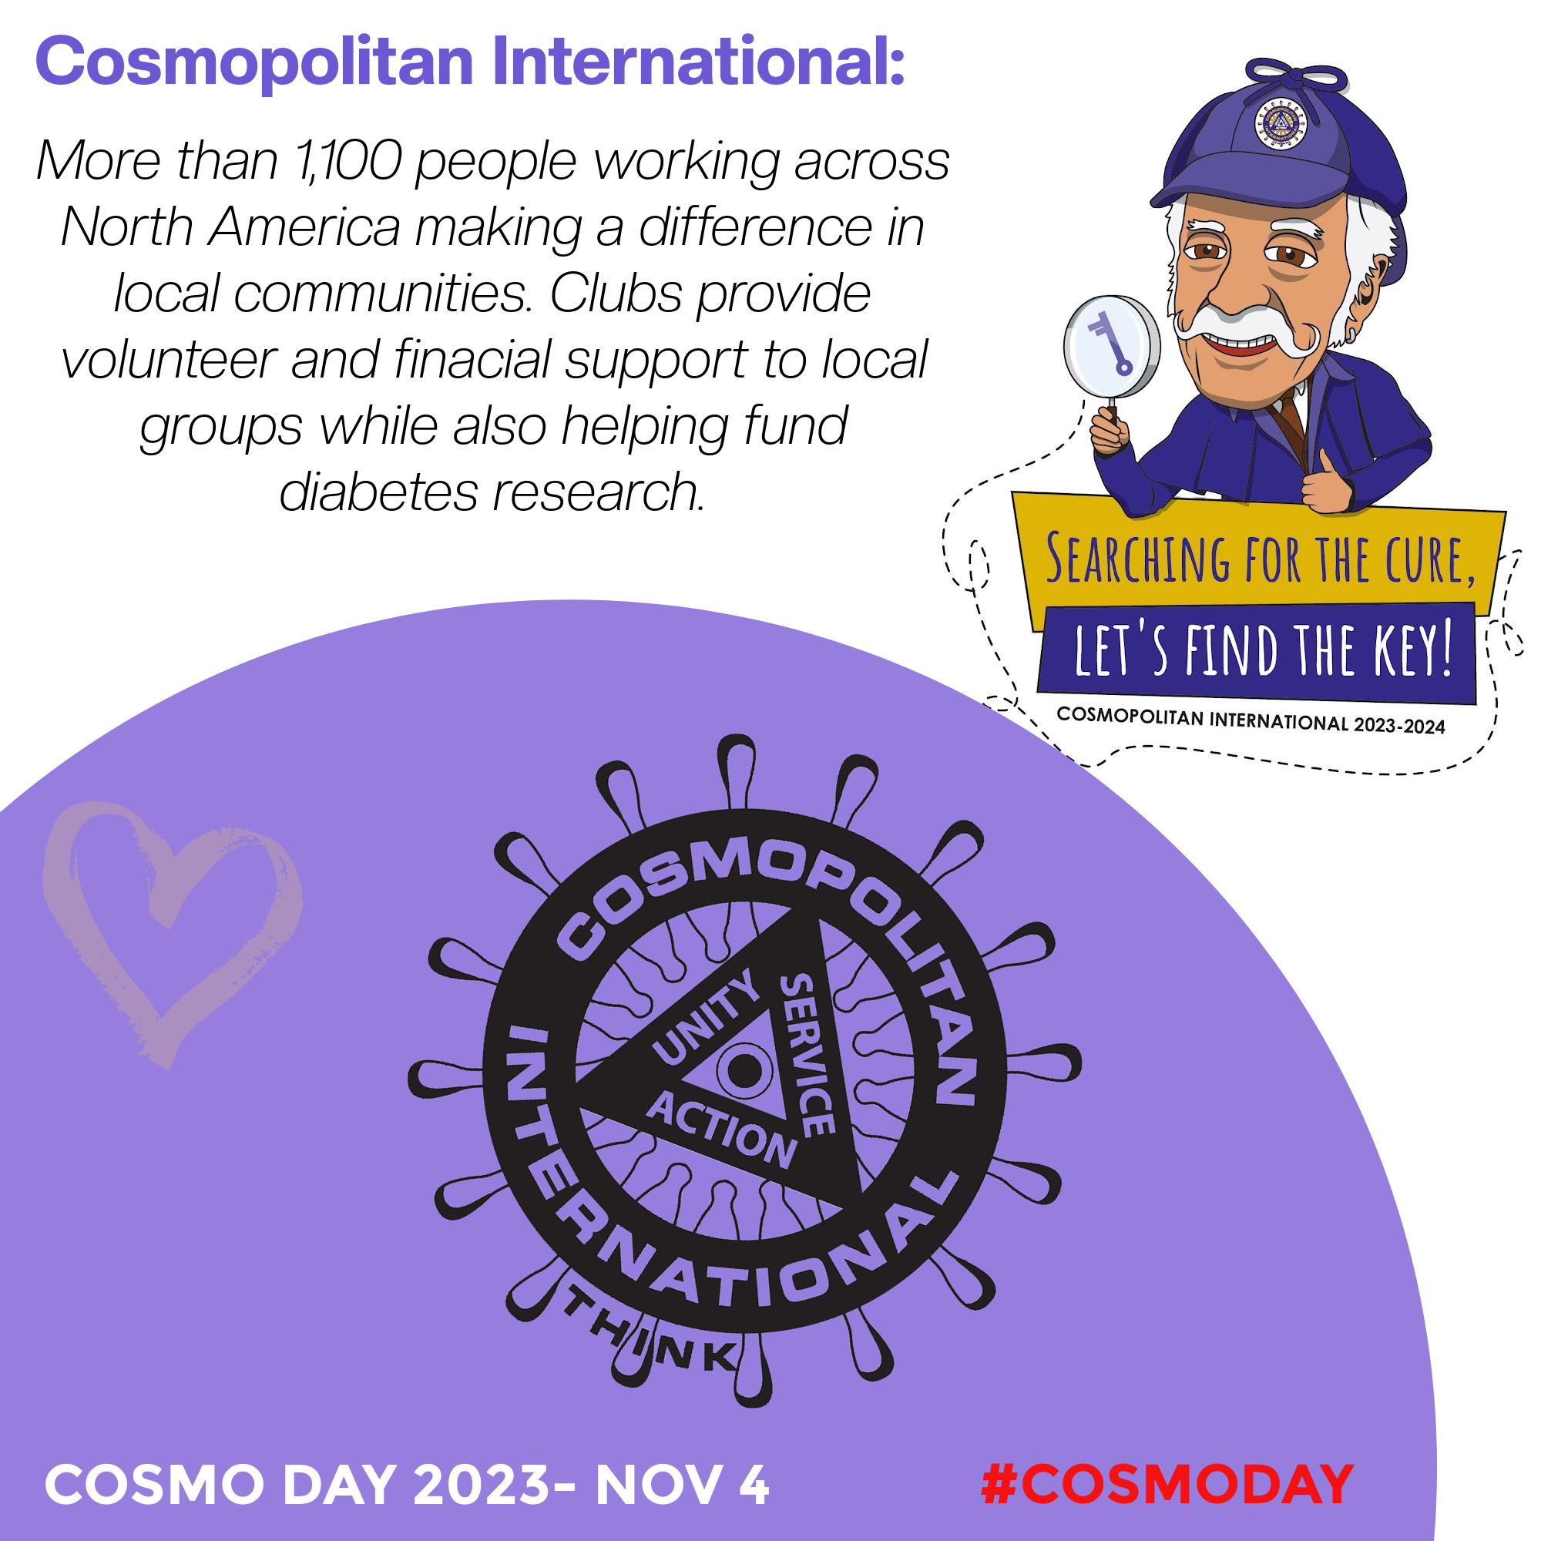
MARKETING SUPPORT 2023 COSMO DAY
Infographics….

Slide 6
MARKETING SUPPORT 2023 COSMO DAY
Infographics….

Slide 7
MARKETING SUPPORT 2023 COSMO DAY
Infographics….

Slide 8
MARKETING SUPPORT 2023 COSMO DAY
Infographics….

Slide 9
MARKETING SUPPORT 2023 COSMO DAY
Infographics….

Slide 10
SOCIAL MEDIA TAGGING
MARKETING SUPPORT 2023 COSMO DAY
Facebook Posts / Instagram Photos / Twitter Plugs
#COSMOS, #WCFCOSMOS, #CFCICOSMOS
#COSMODAY #STOPDIABETES
#YEGCOSMO (sample club level tag)

Slide 11
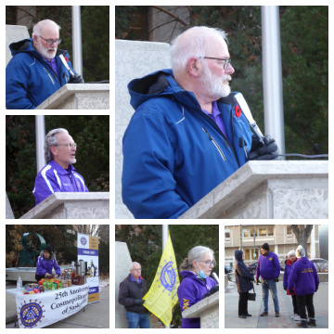
TRADITIONAL MEDIA
PRESS RELEASE (Draft will be provided shortly)
Requires a section on local color from the club level. This should be sent out between October 29th – November 1st to allow assignment desks time to reach out if they decide they would like to include content in their community sections.
PROCLAMATIONS
Applications so be sent into local offices no later than the end of September.
Ideally, we are submitting requests up to 8 weeks before we would like to have them.
Some communities will be able to issue them in shorter notice so please don’t
pass it by because you are a bit late.
Provincial (Should go to the Premier’s Office. they will forward to alternate
office as required.)
Municipal (Send to Mayor’s Office)
Also consider requesting a Community Flag Raising. Clubs can make presentations,
donations etc at the Flag Raising. Saskatoon as done this with great success!

Slide 12
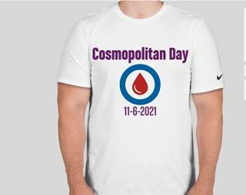
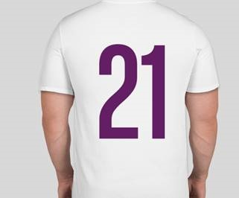
Community Imaging
Tshirts
Banners
Flags
Sample Banner
Sample Shirt form 2021
Partner Cross Promotions (WCF)
Alberta Diabetes Foundation (Annual Funding Announcements, #’s)
DRIFCan (Social Media with #’s)
JDRF (Social Media with #’s)
Other Relevant Community Partnerships

Slide 13
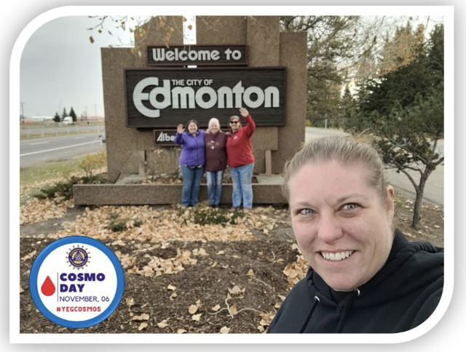
SAMPLE COMMUNITY ACTIVITY (Done annually by ECC)
The Edmonton Cosmopolitan Club struck a committee to consider COSMO DAY and how we could have a presence in the community in some way respecting COVID-19 protocols back in 2020.
A lot of discussion and brainstorming brought us to a city wide “photo bombing” team activity. The Cttee identified a number of locations that held importance to the club. Either because they were icons of our city or because the club is involved with the local organization. All club members who feel comfortable to participate will receive COSMO DAY Tshirts. They will wear these tshirts on that day as we travel around the city to these important locations. We will take a picture of the club members in their tshirts holding our Cosmo Day Banner. A Cosmo Day Tag will be added to the image, and it will be released on social media….”Where will they be next?”
Images will be accompanied by the hashtags. By clicking on a hashtag, you move to a list of all posts using that same tag, regardless of who posted it.
SAMPLE SHOT

Slide 14
COSMOPOLITAN INTERNATIONAL GRAPHIC STANDARDS
Signature Color Pantone Matching System (PMS) is a popular color matching system used by the printing industry to print spot colors. Most applications that support color printing allow you to specify colors by indicating the Pantone name or number. This assures that you get the right color when the file is printed, even though the color may not look right when displayed on your monitor. The following are specified Pantone colors for the Cosmopolitan Logo.
PMS 117C (gold)
PMS 2685C (purple)
RGB is another method of defining colors. Basically, it refers to the percentage of red, green and blue found within an individual color. This is an electronic color system resulting in colors such as those seen on a computer monitor and is based on light. The following are the specified RGB colors for the Cosmopolitan Logo.
R255 G214 B0 (gold)
R142 G0 B255 (purple)

